Slide 1
MOBILE PHONE ADDICTION

Slide 2
Do you……
Reach for your smartphone first thing in the morning?
Check your smartphone last thing at night?
Take your smartphone to the bathroom with you?
Play with your smartphone while people are talking to you?
Look at your smartphone even although it isn’t doing anything?
Have to charge your smartphone more than once a day?

Slide 3
What is MOBILE ADDICTION???

Slide 4
What is addiction?
An addiction is the state of being enslaved to a habit or practice which we do regularly.
Addiction is when a person becomes dependent on something and feels like they can't go without it.

Slide 5
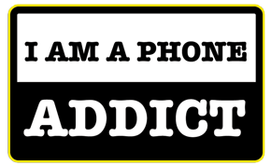
Mobile phone addiction
The usage of cell phones has become very addicting for the people in the world today.
Those people who can’t be without using mobile phones are addicted to phones that is called mobile phone addiction.

Slide 6
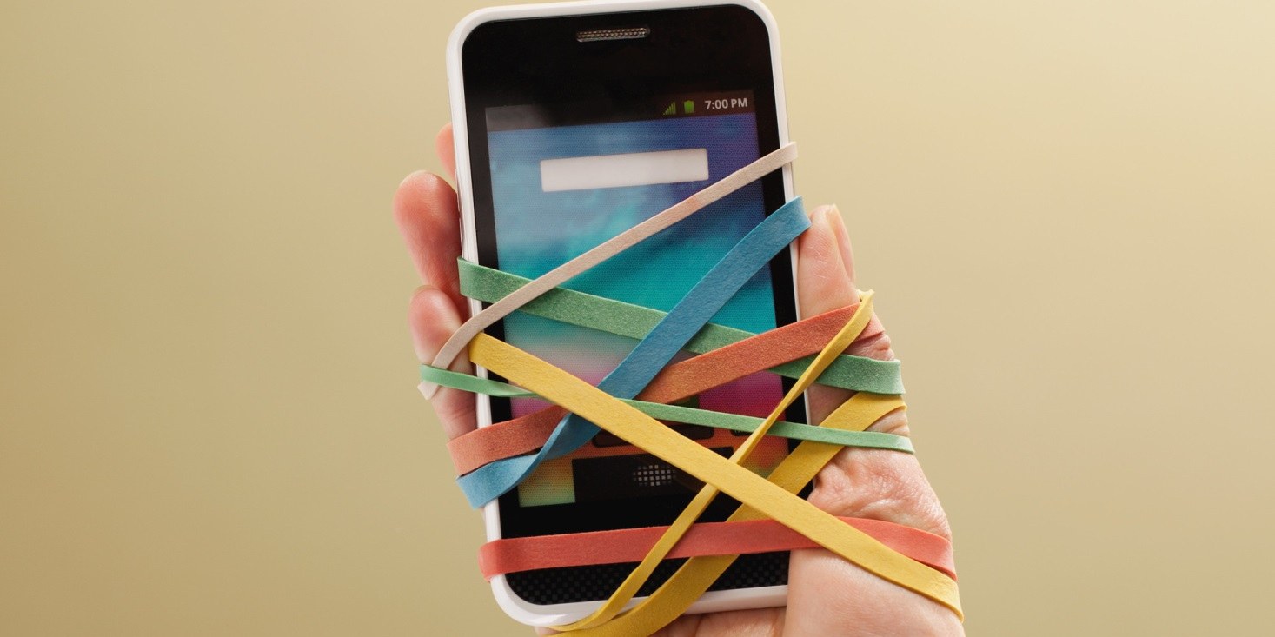
This is how we got addicted to mobile phone

Slide 7
Getting strucked to our mobile phones even when there are many people around us.

Slide 8
Why are we getting addicted???

Slide 9
facebook,
What's app,
Twitter,
Gmail,
new apps,
Google etc.,

Slide 10
What is its impact on people?

Slide 11
impact on people
Mental disorders,
Sight problems,
Head aches,
Hearing problems
Psychological disorders, etc

Slide 12
Effects of addiction
Mobile phones release many radiations which are very harmful for the human beings. Which are called MOBILE PHONE RADIATIONS.
Doctors call the issue of mobile phone addiction as "problem mobile phone use".

Slide 13
That is called as mobile phone addiction.

Slide 14
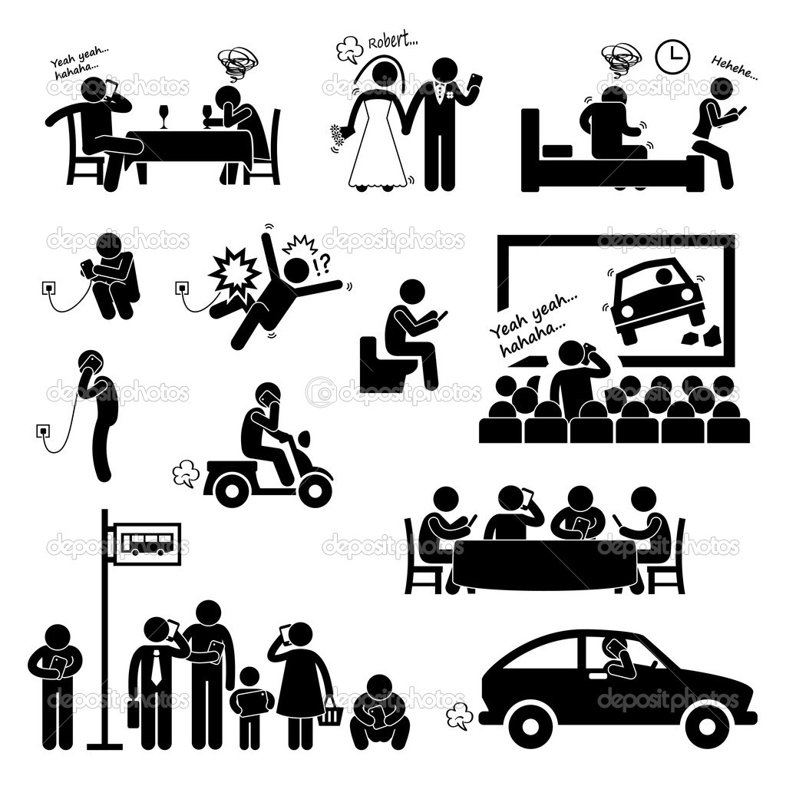

Slide 15
These are the three main things that had become horrible in our life now-a-days.

Slide 16
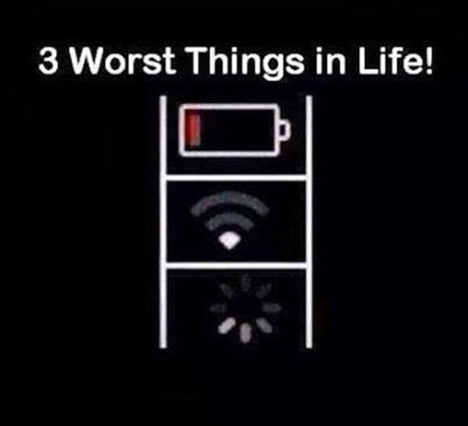

Slide 17
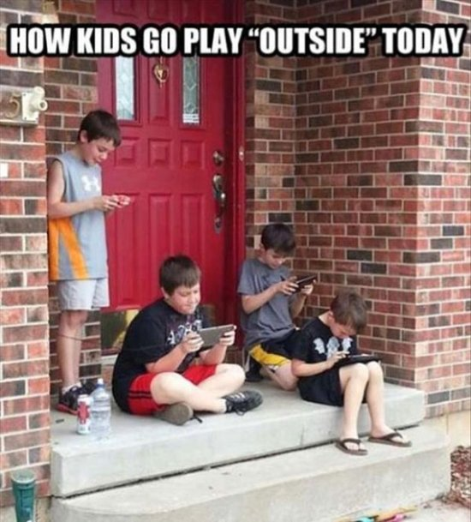

Slide 18
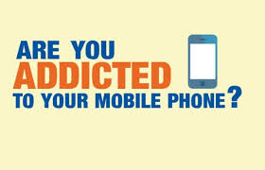
Are we getting addicted??

Slide 19
Answer these
01 | Do you have your cell phone with you constantly, even at home you have it in your pocket or right next to you?
02 | Do you find someone to call as soon as you leave the classroom?
03 | Do you always feel anxious about your cell phone, especially when you are unable to use it ? (eg. in class)
04 | Do you take cell phone breaks while doing homework?
05 | Do you experience high levels of anxiety, stress, or insecurity whenever you are without your cell phone?
06 | Do you sometimes feel that your phone is ringing, but when you answer it or listen longer you find it wasn't ringing at all. (known as 'phantom ringing')?

Slide 20
Because you are already
ADDICTED
to your mobile phone

Slide 21
How does
MOBILE ADDICTION
happen?

Slide 22
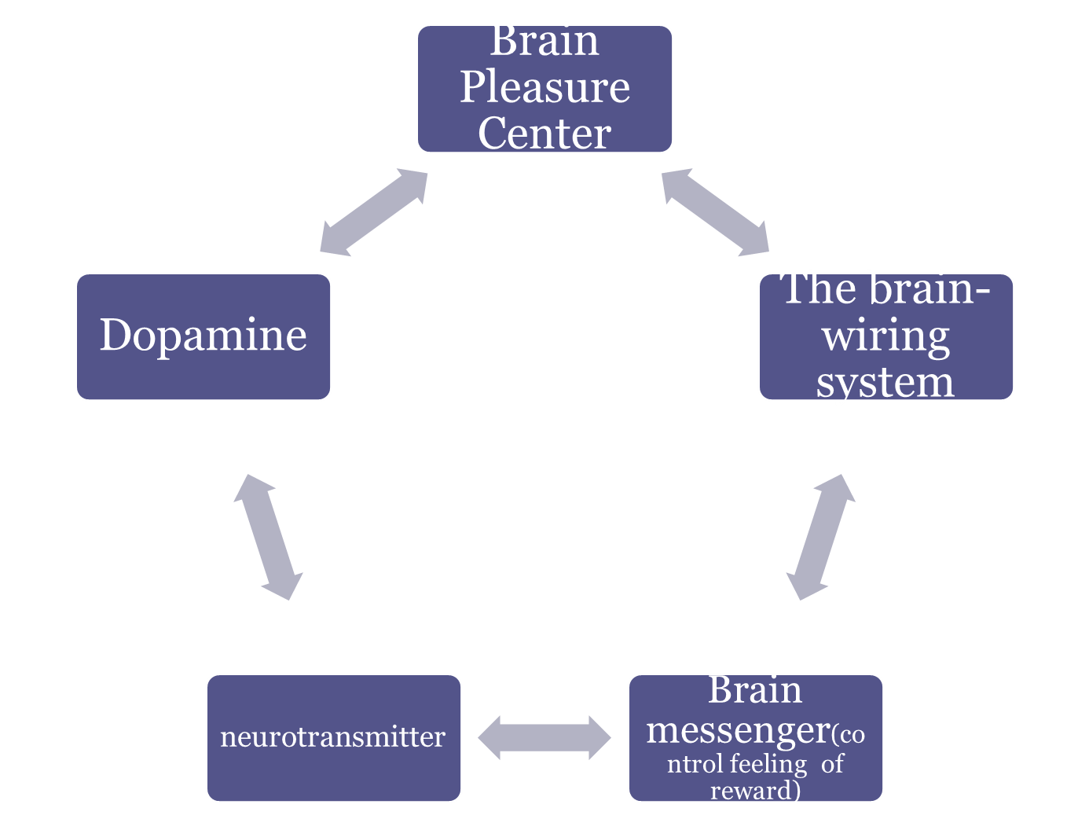
ADDICTION

Slide 23
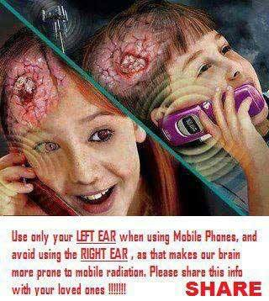

Slide 24

Finally,

Slide 25
Teenage is less and now you are almost 17,18 or 19 yrs.
You have a very less span of our teenage so enjoy it but don’t waste it in getting addicted to the mobile.

Slide 26


Slide 27
Already mobiles had replaced many a things in our life such as calendars, calculators and many more but don’t let them replace your relationships.

Slide 28
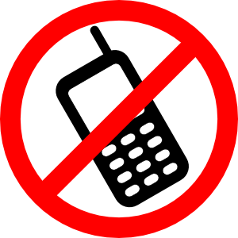

Slide 29
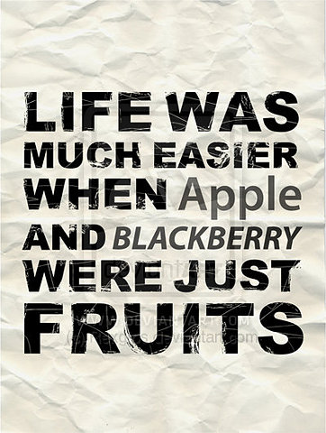

Slide 30
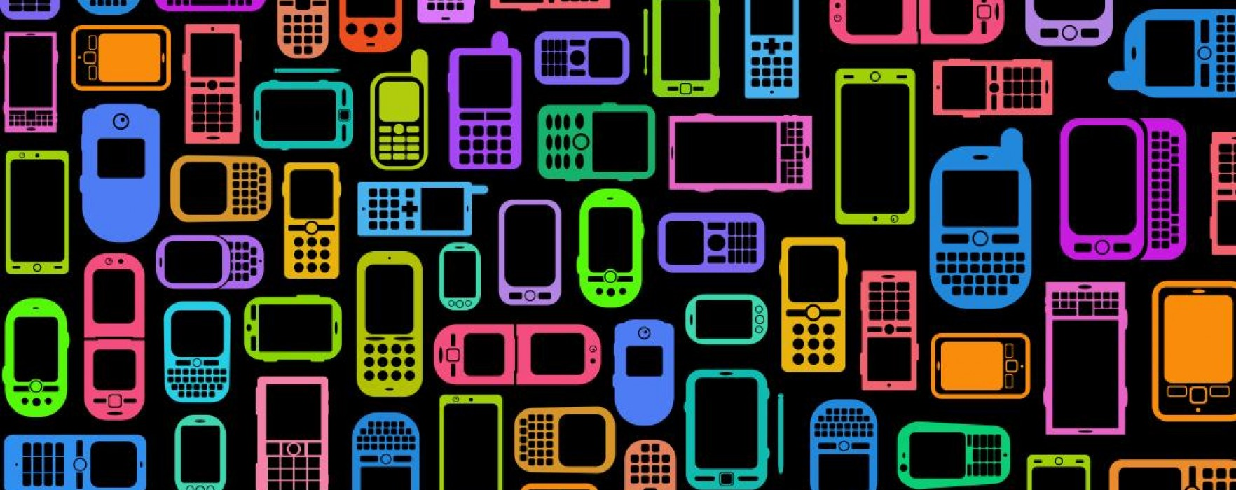
thank you

